Slide 1
BRIDGE COURSE of INFORMATION & COMMUNICATION TECHNOLOGY
Activity 2 :
Understand the working of different input/output hardware devices

Slide 2
Objectives of the activity
After Completion of this activity Students will be able,
To Easily identify the input/output devices
To use various I/O Devices.

Slide 3
INPUT DEVICES
What is an INPUT DEVICE ?
Entering data or instructions into a computer is called input. Therefore, an input device is a device which enters data or instructions into a computer.
Input devices are necessary to convert data into a form which can be understood by computer.

Slide 4
Some input devices :

Slide 5
Keyboard
A keyboard is the most common input device.
The keyboard in most common use is the QWERTY board.
Generally standard keyboard has 104 keys.

Slide 6
Parts of Keyboard

Slide 7
Mouse
The mouse is a small device used to point to a particular place on the screen and select in order to perform one or more actions.
It can be used to select menu commands, size windows, start programs etc.

Slide 8
Mouse
Mouse Actions
Left Click : Used to select an item.
Double Click : Used to start a program or open a file.
Right Click : Usually used to display a set of commands.
Drag and Drop : It allows you to select and move an item from one location to another. To achieve this place the cursor over an item on the screen, click the left mouse button and while holding the button down move the cursor to where you want to place the item, and then release it.

Slide 9
Parts of Mouse

Slide 10
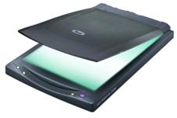
Scanner
A scanner is a device that captures images from photographic prints, posters, magazine pages, and similar sources for computer editing and display.
Scanners come in hand-held, feed-in, and flatbed types and for scanning black-and-white only, or color.

Slide 11
Parts Of Scanner

Slide 12
OUTPUT DEVICES
What is an OUTPUT DEVICE ?
The information we get from the computer is known as output.
Output devices return processed data that is information, back to the user.
An output device is any peripheral device that converts machine-readable information into people-readable form such as a monitor, printer, plotter and voice output device.

Slide 13
Some Output Devices:

Slide 14
Monitor
The Monitor is one of the most important output devices, it is used to display text and pictures. The monitor is also known as the Visual Display Unit(VDU).
Two basic types of monitors are used with microcomputers, which are as follows:
1. CRT(Cathode Ray Tube)
2. Liquid-Crystal Displays(LCDs)

Slide 15
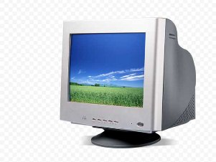
Monitor
Cathode Ray Tube(CRT)
Liquid-Crystal Display(LCD)

Slide 16
Printer
A printer is an output device that produces a hard copy of data on to a paper. The resolution of printer output is expressed as DPI (Dots per inch).
Some printers offer special features such as colored and large page formats. Some of the most commonly used printers are:
1. Laser Printer
2. Ink Jet Printer
3. Dot Matrix Printer
4. Line Printer

Slide 17
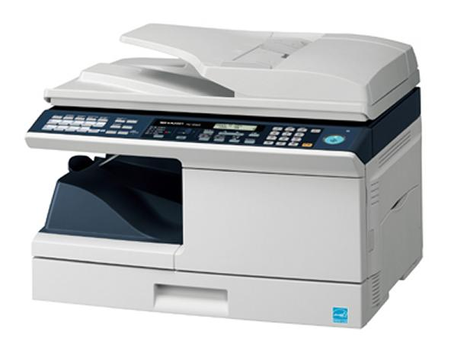
Laser Printer
A laser printer produces high quality print that one normally finds in publishing. It is extremely fast and quiet.
The fastest laser printer can print up to 200 pages per minute in monochrome (black and white) and up to 100 pages per minute in color.

Slide 18
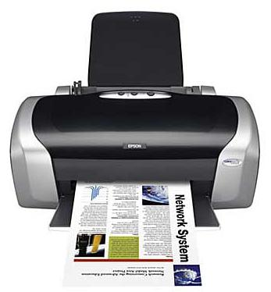
Ink Jet Printer
An ink-jet printer creates an image directly on paper by spraying ink through as many as 64 tiny nozzles.
Ink-jet printer is more expensive than a dot-matrix printer, but costs only half as much as a laser printer.

Slide 19
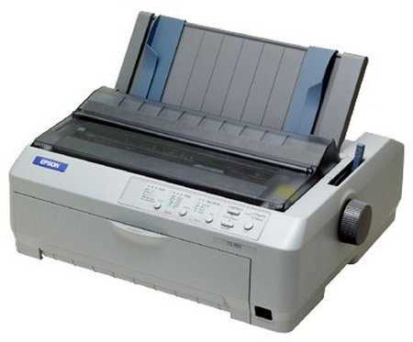
Dot Matrix Printer
The dot matrix printer was very popular at one point of time. It is a very versatile and inexpensive output device.
In dot matrix printer the print head physically "hits" the paper through the ribbon and produces text (or images) by combinations of dots; hence the name dot matrix printer.
Its speed is measured in characters per second (CPS).

Slide 20
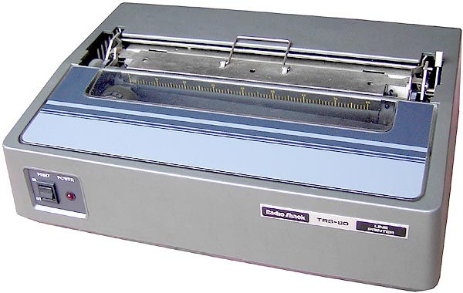
Line Printer
A line printer is generally used with large computer systems to produce text based data processing reports.
Line printers are high-speed printers with speeds ranging anywhere from 100 to about 3800 lines per minute.

Slide 21
References:
http://prepare.icttrends.com/m/gold/textbooks/text-book-for-fundamentals-of-computer/computer-hardware-concept/
http://penta.com.au/keyboard-microsoft-c469_470_1196/microsoft-wired-dsktop-keyboard-and-mouse-600-apb-00018
http://www.docstoc.com/docs/49015520/Scanner-Parts-Scanner-Specifications---PDF

