Slide 1
BRIDGE COURSE of INFORMATION & COMMUNICATION TECHNOLOGY
Activity No. 10
using internet services for communication like email, chat Etc.

Slide 2
Objectives of the activity
Students will be able to learn
Communication through email .
Perform live chatting

Slide 3
E-mail
What is E-mail?
Email Stands for Electronic mail most commonly referred to as email or e-mail since approximately 1993.
It is a method of exchanging digital messages from an author to one or more recipients.
The digital massage may be in form of text, image, audio, video, etc.
It doesn't require to be online at same for sender and receiver they need to connect to email server for as long as it takes to send or receive messages

Slide 4
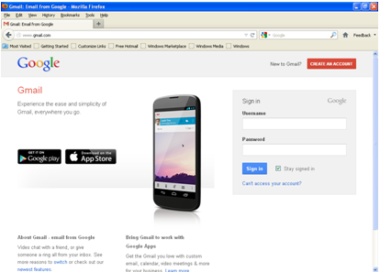
How to Create E- Mail Id?
Here we look at an example to create Email id in Gmail.
Open web browser and Write www.gmail.com in address bar and press enter.
It will open Gmail homepage as shown in fig

Slide 5
How to Create E- Mail Id?
Click on Create Account button

Slide 6
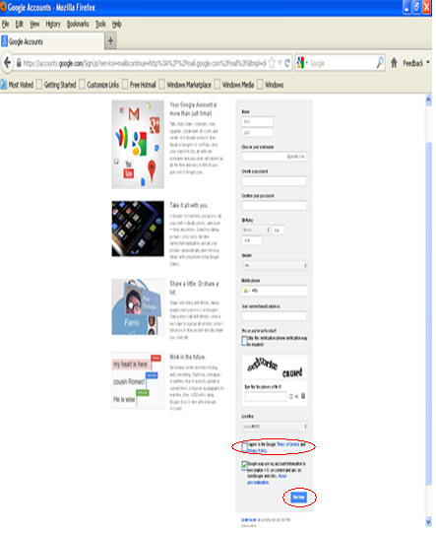
How to Create E- Mail Id?
It will Open information feel up form.
Feel up all information, click on accept terms and services and click on next button
Note that Email Id is the unique id in the world so it will not allow duplicate.

Slide 7
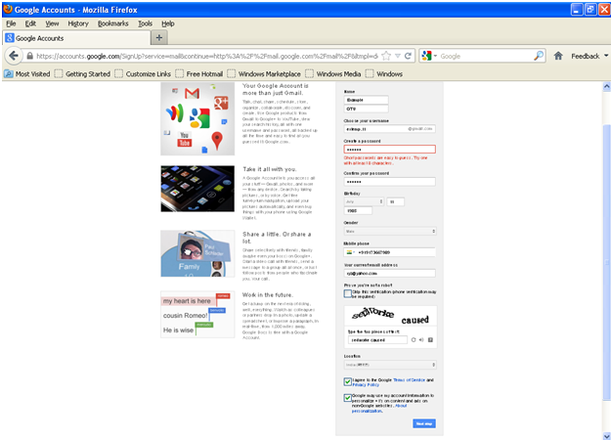
How to Create E- Mail Id?

Slide 8
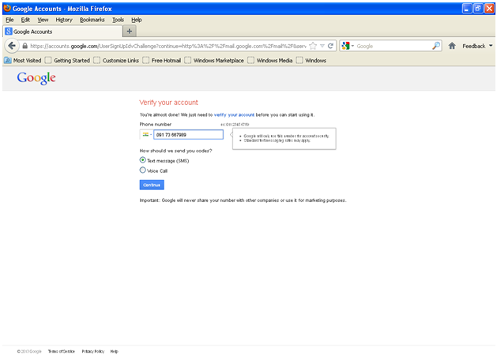
Verify your contact detail here and click on continue

Slide 9
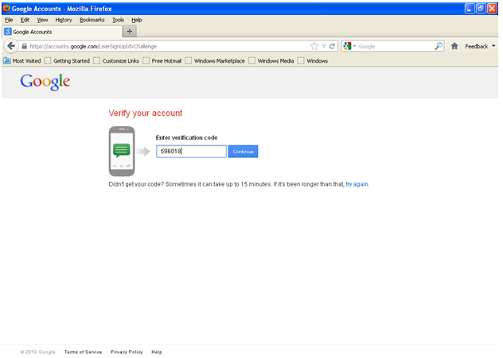
Enter the verification code you received as text message(sms) on mobile number.
Click on Continue button

Slide 10
It will show a welcome page .
Click on Continue.

Slide 11
It will show you inbox with some well come messages.
To read particular message click on the message it will show you detailed message

Slide 12
How to send an Email
Open web browser and Write www.gmail.com in address bar and press enter.
It will open Gmail homepage as shown in fig
Enter your user name and password and Click on Sign In button

Slide 13
How to send an Email
It will open a new message window
In recipients box enter mail address to whom you want to send email
In subject box enter the subject i.e. purpose of email.
Write your message in big blank text and click on send button

Slide 14
How to send an Email

Slide 15
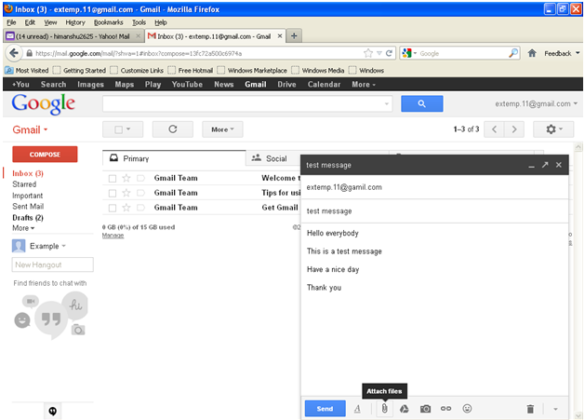
Attachments with E-mail
If you want to send any image audio or video file then click on attachment button and upload your file

Slide 16
Live chatting
There are many messengers available which provide live chatting facilities.
For e.g. Yahoo, MSN, Google talk, etc.
Social media such as Face book , Google's Hang outs, Tweeter are also provide live chatting.
Many Banks, Service providers also Use Live Chat to provide support to their customers.
For live chatting both sender and receiver must have to online.
We can share text messages, audio and video files thru it.

Slide 17
We Can create a new account for messenger or we can use our existing email id for messenger.
Next figures show yahoo messenger and Google Talk
We will take an example of Google talk .

Slide 19
Enter your Gmail email id and password and click on Sign in button
Satvik_Khara

Slide 20
It will logon you to messenger
To add new contacts click on Add button

Slide 21
Enter the email address of person you want to add as your friend and click on next button

Slide 22
Click on the finish button and that person is invited to your friend list

Slide 23
When the person accept your request and becomes online shown you as available in your friends list

Slide 24
To start chat with that person click on the person’s id, it will open small window to start chatting
In small text box write your message and press enter
Now your friend can read and reply.

Slide 25
Mobile applications like WhatsApp , Livechat, Gtalk also provide live chatting option.
This is an example of WhatsApp mobile application for live chat:

Slide 26
Your Gmail account also provides you live chat option
The contacts shown with green bullets are online.

Slide 27
References:
http://www.computerhope.com/jargon/e/email.html
http://wikipedia.org

